Slide 1
Jana
Reallocation of financial resources in a cattle breeding program

Slide 2


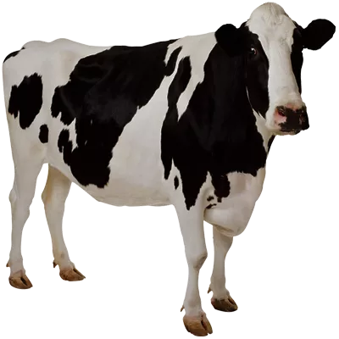
Resource allocation
Conventional selection
for phenotyping
Dairy cattle
ICAR milk recording schemes:
A4 = 11 recordings / lactation
$
$
$
$
$
$
$
$
$
$
$

Slide 3

Resource allocation
Conventional selection
for phenotyping
Dairy cattle
ICAR milk recording schemes:
A4 = 11 recordings / lactation
$
$
$
$
$
$
$
$
$
$
$

Slide 4


Resource allocation
Conventional selection
for phenotyping
A6 = 8 recordings / lactation
REDUCE PHENOTYPING
$
$
$
$
$
$
$
$
Genomic selection
$
$
$
= for phenotyping
for genotyping =

Slide 5
Resource allocation
Conventional selection
for phenotyping
No phenotype recordings
Price of phenotyping
REDUCE PHENOTYPING
Price of genotyping
Use genotypes for
selection / update
Genomic selection
= for phenotyping
Number of animals for
selection / update
for genotyping =

Slide 6
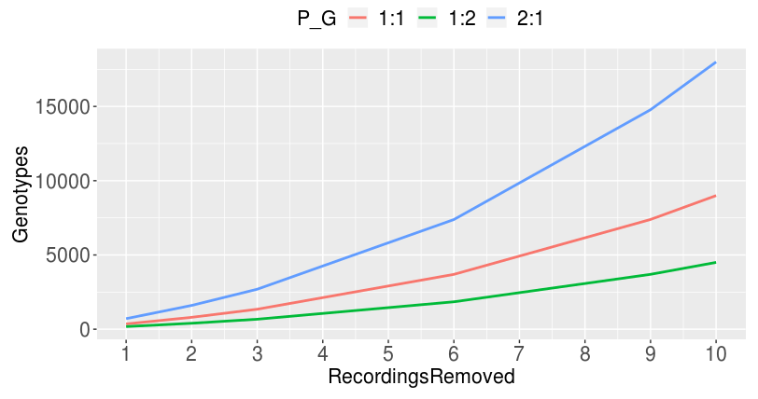
Resource allocation
Price of phenotyping → phenotype vs genotype = 2:1, 1:1, 1:2
How many genotypes if we remove #recordings

Slide 7
F = update
M = selection
Resource allocation
Phenotype: Genotype
NoControls Reduced
Which animals to genotype
Reference
1
1:1
1
2
YES
2
3
X% female
Y% male
6
9
10
2:1
1
2
2
3
X% female
Y% male
6
9
10
1:2
1
2
2
3
X% female
Y% male
6
9
10
1
1:1
1
2
NO
2
3
X% female
Y% male
6
9
10
2:1
1
2
2
3
X% female
Y% male
6
9
10
1:2
1
2
2
3
X% female
Y% male
6
9
10

Slide 8
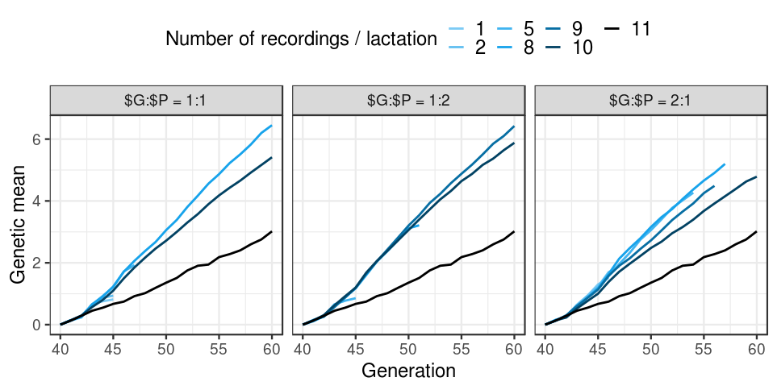
Resource allocation
Very! preliminary results

Slide 9
Resource allocation
Limitation: blupf90 – 25K genotyped animals
“Reference:yes” scenarios running with the 25K limit
Still figuring out the code for “Reference:no” scenarios
When to starting selecting males?

